Slide 1
Introductory General Chemistry
Chemistry 3A
S. M. Halloran

Slide 2
Discovery of Radioactivity
Radioactivity Types: Alpha, Beta, Gamma
Half-Life in Radioactivity
Nuclear Chemistry: Purposeful Use of Radioactivity

Slide 3
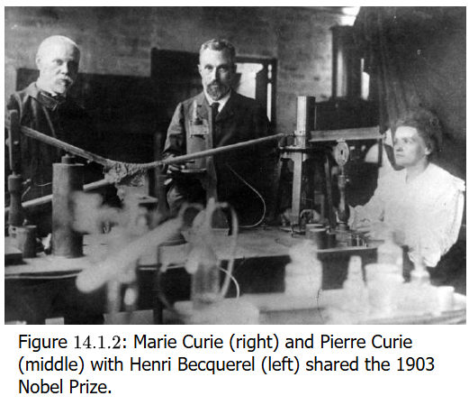
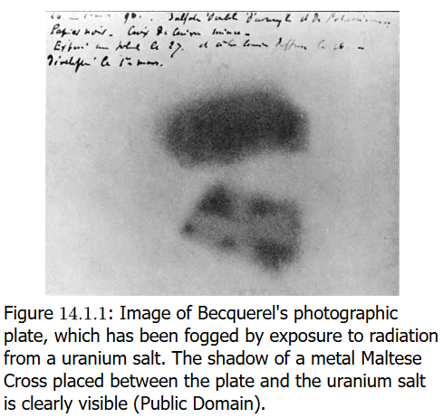
Discovery of Radioactivity
Roentgen learns that X-radiation can also expose photographic film
Becquerel learn if fluorescent minerals can have same effect (no), but sees that one rock with uranium salt minerals fogged the photographic plate
Marie & Pierre Curie determine that the element radium has even more radioactivity than uranium

Slide 4
Nuclear Binding Energy
Except for ¹H nucleus, all atoms have multiple protons in a nucleus
As like charges repel, something must keep protons held together in the nucleus. This is a force called nuclear binding energy
This binding energy keeps nuclei stable. But too little binding energy can lead to natural radioactivity (nuclear disintegration)
Scientists can force (smash) nuclei together to cause artificial radioactivity
All kinds of radioactivity (nuclear disintegration) leads to energy release

Slide 5
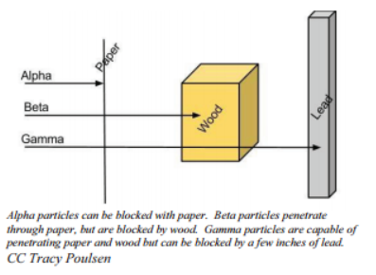
Alpha, Beta, Gamma Radioactivity
All nuclei with 84 and more protons are radioactive, and those with less have stable and unstable isotopes
The decay of radioactive isotopes can be alpha, beta, and gamma
The radiation of this nuclear disintegration can be damaging to atoms and the molecules/compounds of which they are part, and to cells and tissues in which these compounds exist
The energy of the radiation can cause ionization, usually by knocking out electrons from atoms
However, some radiation can be blocked, indicating some protection

Slide 6
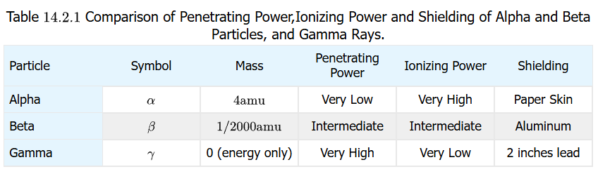
Ionization versus Penetrating Power
Generally there is a trade-off in ionizing power versus penetrating power
Alpha particles have a large mass compared to beta particles & gamma rays, so they do not penetrate very much. But they have considerable ability to ionize and damage molecules/compounds
Beta particles have far more penetrating power but less ionizing power
Gamma rays have no mass, are most penetrating, but less ionizing compared to alpha and beta particles

Slide 7
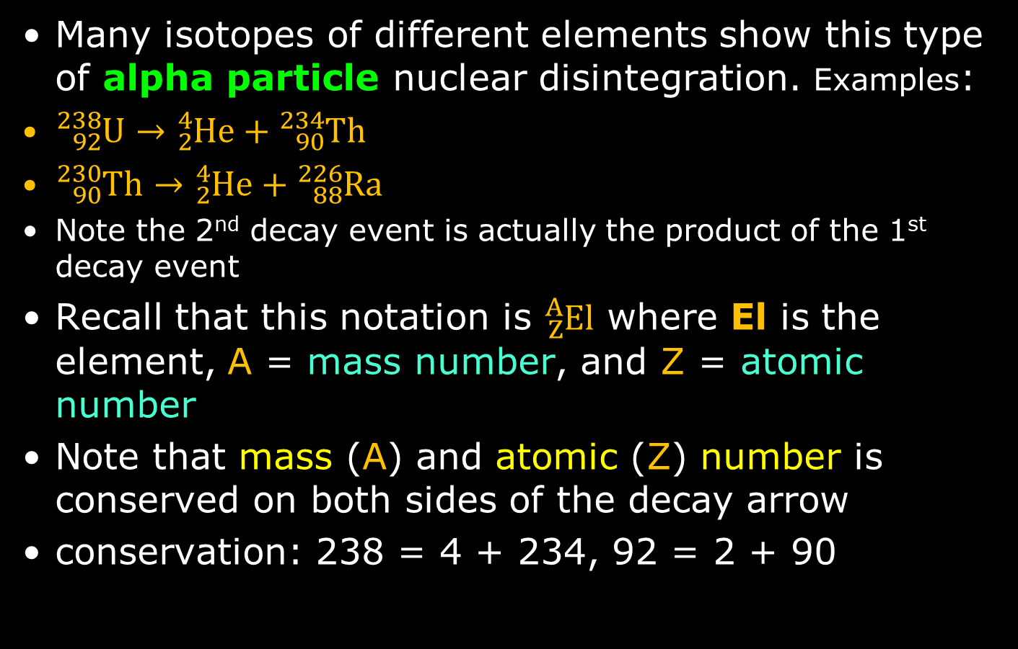
Alpha Decay
Many isotopes of different elements show this type of alpha particle nuclear disintegration. Examples:
${}_{92}^{238}U→{}_{2}^{4}{He}+{}_{90}^{234}{Th}$
${}_{90}^{230}{Th}→{}_{2}^{4}{He}+{}_{88}^{226}{Ra}$
Note the 2nd decay event is actually the product of the 1st decay event
Recall that this notation is ${}_{Z}^{A}{El}$ where El is the element, A = mass number, and Z = atomic number
Note that mass (A) and atomic (Z) number is conserved on both sides of the decay arrow
conservation: 238 = 4 + 234, 92 = 2 + 90

Slide 8
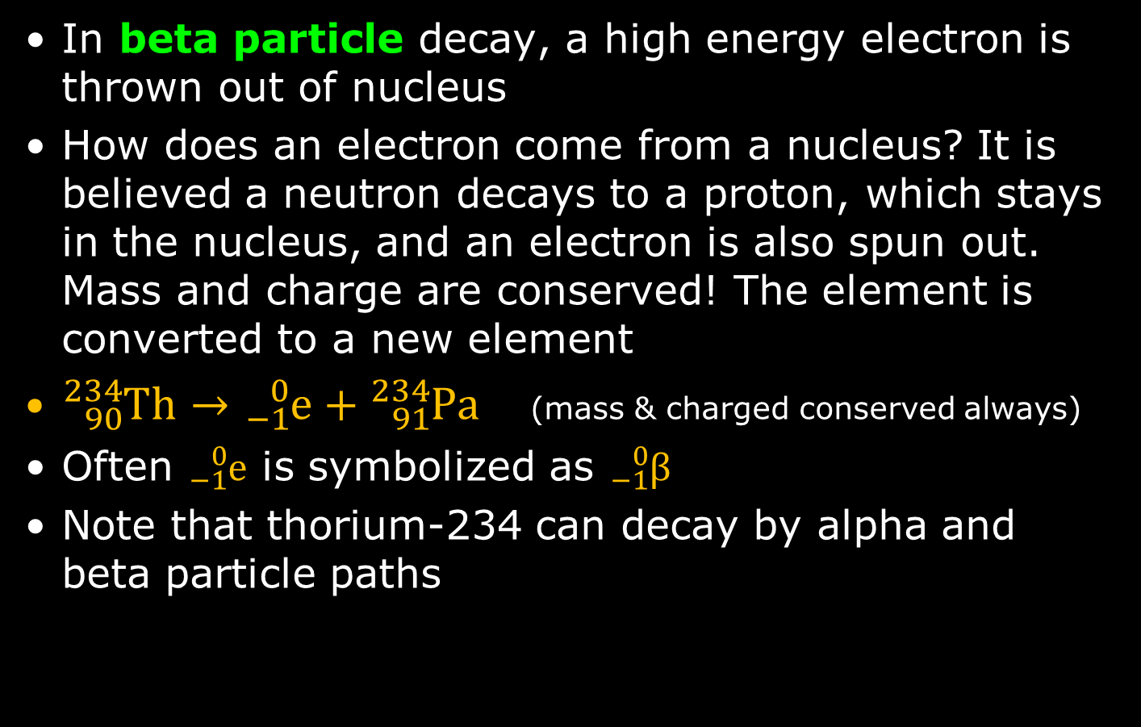
Beta Decay
In beta particle decay, a high energy electron is thrown out of nucleus
How does an electron come from a nucleus? It is believed a neutron decays to a proton, which stays in the nucleus, and an electron is also spun out. Mass and charge are conserved! The element is converted to a new element
${}_{90}^{234}{Th}→{}_{−1}^{0}e+{}_{91}^{234}{Pa}$ (mass & charged conserved always)
Often ${}_{−1}^{0}e$ is symbolized as ${}_{−1}^{0}β$
Note that thorium-234 can decay by alpha and beta particle paths

Slide 9
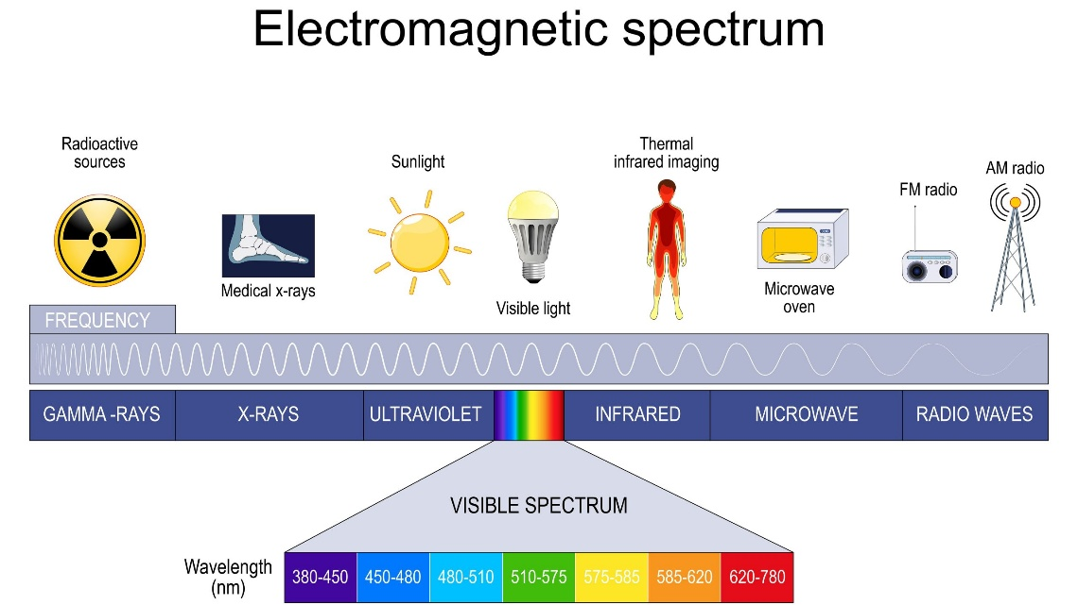
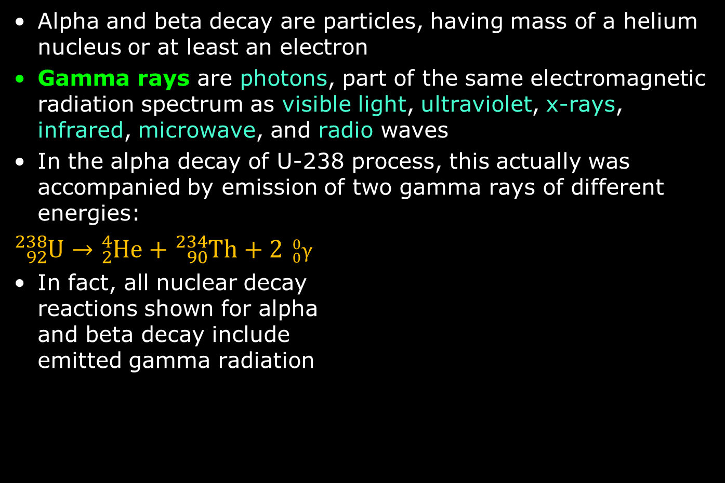
Gamma Radiation
Alpha and beta decay are particles, having mass of a helium nucleus or at least an electron
Gamma rays are photons, part of the same electromagnetic radiation spectrum as visible light, ultraviolet, x-rays, infrared, microwave, and radio waves
In the alpha decay of U-238 process, this actually was accompanied by emission of two gamma rays of different energies:
${}_{92}^{238}U→{}_{2}^{4}{He}+{}_{90}^{234}{Th}+2$ ${}_{0}^{0}γ$
In fact, all nuclear decay reactions shown for alpha and beta decay include emitted gamma radiation

Slide 10
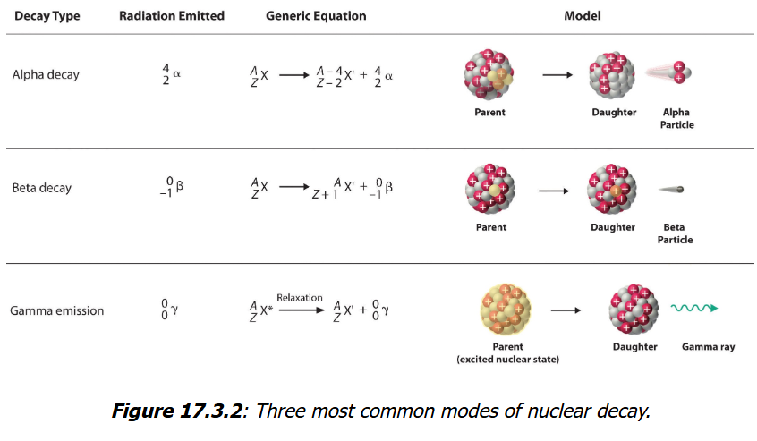
Summary
All radioactivity involves significant energies
Chemical bond energy releases are up to 10³ kJ/mol
But radioactivity is from 10⁸ to 10¹⁰ kJ/mol, about a million times more energy

Slide 11
“Nuclear Accounting”
Mass is conserved: both atomic (Z) and mass (A) numbers must equal on both sides of the decay arrow
Nuclear—not electron(ic)—charge is conserved in these equations. Generally the effect on electrons orbiting an atom involved in nuclear decay are not accounted for and the effect unknown. The nuclear charge effect is reflected in the changes of the atomic number (Z value), since Z is a direct count of the protons in a nucleus

Slide 12
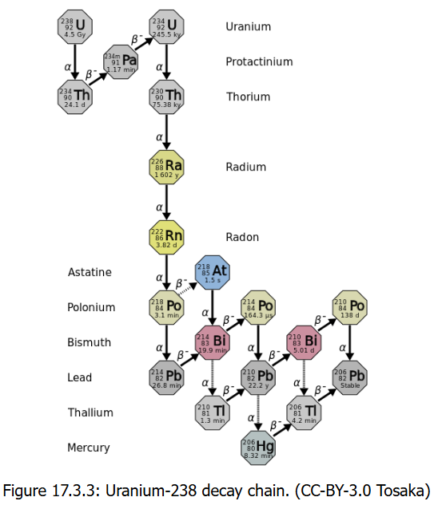
A Series of Decay
The U-238 isotope will actually undergo a series of decays as it progresses to an isotope that is stable
A total of 14 decays will occur as U-238 decays to Pb-206.
U-235 will decay to Pb-207
Th-232 will end in Pb-208
Billions/millions of years ago there may have been Radon naturally but it has all decayed.

Slide 13
Half-Life
Amount of radioactivity as it decays clearly decreases with time
Period of time for that amount of radioactivity to decrease by half (50%) is called the half-life
Half-life is symbolized by t_{1/2}.
Half-lives for many isotopes can range from nanoseconds to billions of years
Period Range | Approximate Value | Example Isotope | Use/Context
Extremely Short | Nanoseconds (10⁻⁹ s) | Polonium-212 (299 ns) | Part of the uranium decay series.
Seconds/ Minutes | Seconds (10⁻² to 10³ s) | Oxygen-15 (≈2 minutes) | Used in Positron Emission Tomography (PET) scans.
Hours/Days | hours to days (10³ to 10⁶ s) | Technetium-99m (≈6 hours) | Most widely used medical diagnostic isotope.
Years/ Centuries | years to centuries (10⁷ to 10¹⁰ s) | Cesium-137 (≈30 years) | Nuclear fallout/waste.
Geological Time | thousands to billions of years (10¹¹ to 10¹⁷ s) | Carbon-14 (≈5,730 years) | Used for carbon dating.
Primordial | billions of years (10¹⁷ s +) | Uranium-238 (≈4.5 billion years) | Used for geological dating of Earth rocks.

Slide 14
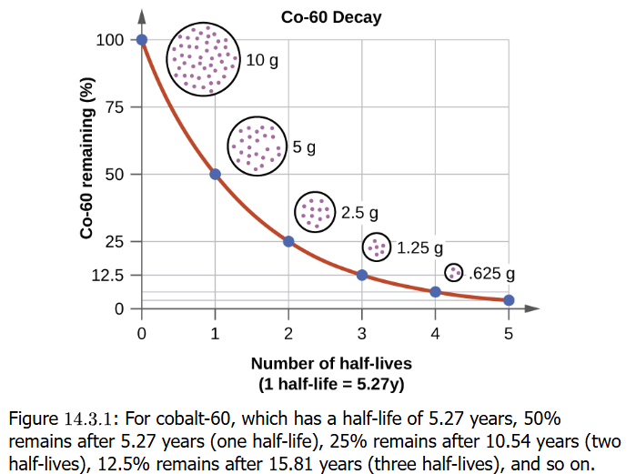
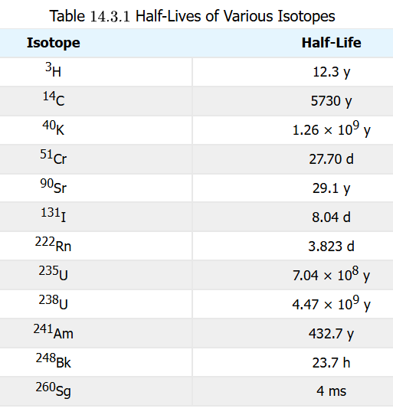

Half-Life
Cobalt-60 has a half-life of 5.27 y
If at time t = 0, there is 10 g cobalt-60, at time t = 5.27 y, there will be 5 g. At time t = 10.54 y, there will be 2.5 g
At t = 15.81 y, now 1.25 g, and at t = 21.08 y, which is 5 half-lives, the amount remaining is now 0.625 g
It follows a curve: $A=A_{0}$

Slide 15
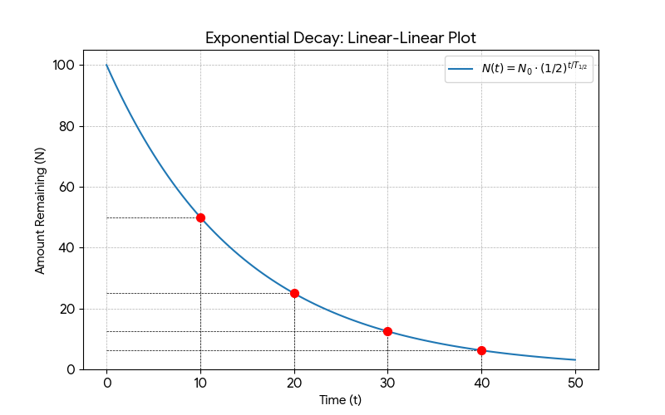
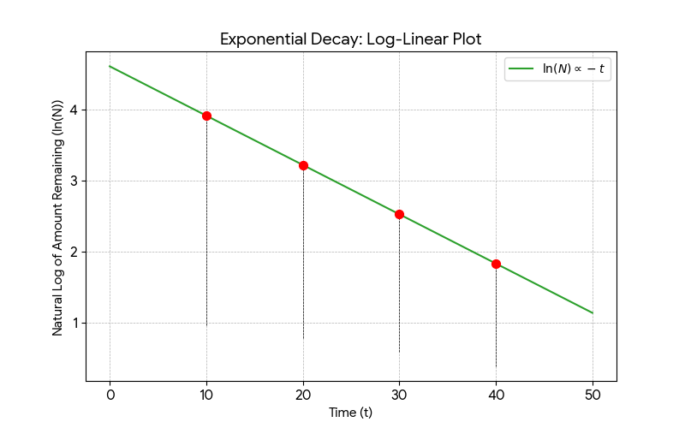

Half-Life
The math involving first-order (only one reactant) process that is radioactive decay is so important it must be understood graphically
Flourine-20 has t_{1/2} =11.0 s. If initial sample is 5.00 g of fluorine-20, how much is left after 44.0 s?
$A=5.00 g ×{\left(\frac{1}{2}\right)}^{4}=5.00 g ×$ $\left(\frac{1}{16}\right)=0.313 g$

Slide 16
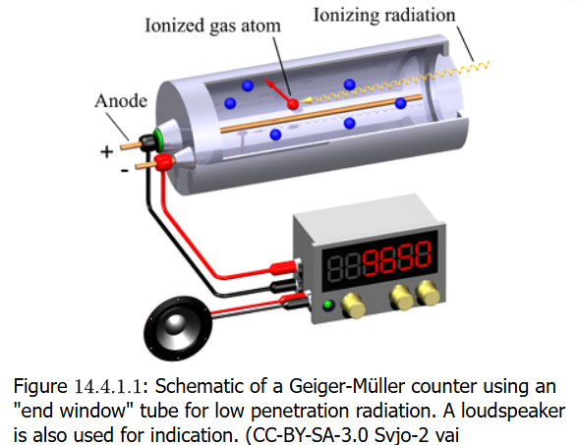
Detecting Radioactivity
Because alpha, beta, and gamma radiation is ionizing, instruments like a Geiger-Muller tube can be constructed to detect ionizations of gases in the instrument as electric currents created to register counts and to hear the count as an audible “click”
These counts occur without any identifiable source of radiation. This is called background radiation

Slide 17
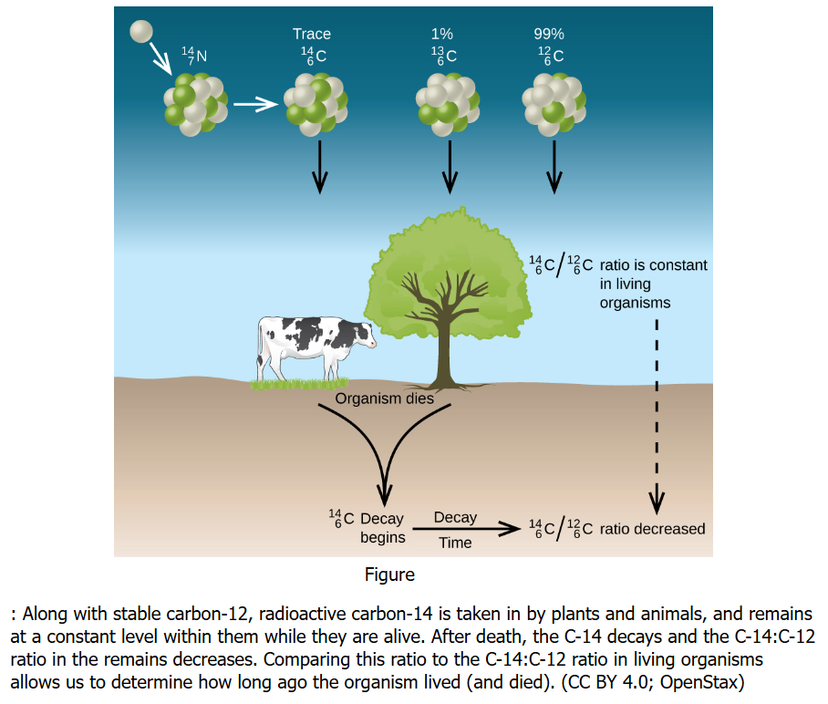
Radiometric Dating
Radioisotopes can be used date object origin
Carbon-14 in particular can be used to date things that were living organisms (radiocarbon or carbon-14 dating)
Carbon-14:carbon-12 ratio can be used to determine how long ago an organism lived. Ratio is constant while organism is alive, but decreases after death

Slide 18
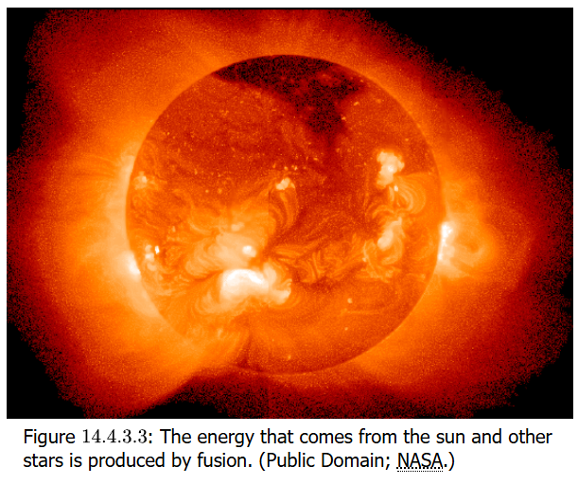
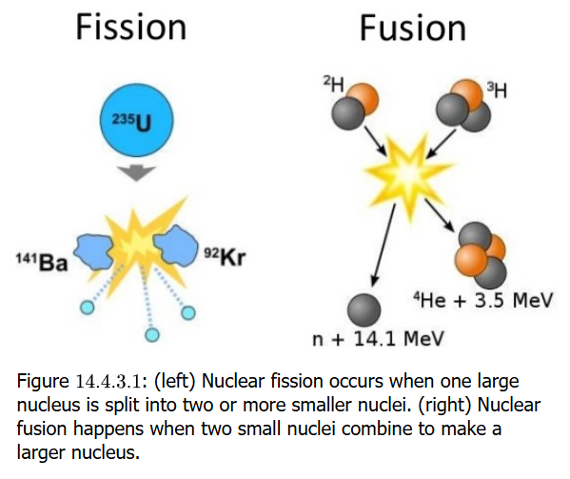

Atomic Fission & Fusion
Fission reactions are when nuclei break up into two or more smaller nuclei
In the fission reactor:
$${}_{92}^{235}{U+{}_{}^{1}n}→{}_{56}^{141}{Ba+}{}_{36}^{92}{Kr}+3{}_{}^{1}n+200 MeV$$
Fusion reactions are when nuclei are brought together to form larger nuclei
In the Sun:
$${}_{1}^{1}H+{}_{1}^{1}H→{}_{1}^{2}{H+}{}_{1}^{0}{e^{+}}$$
$${}_{1}^{2}H+{}_{1}^{1}H→{}_{2}^{3}{H+}γ$$
$${}_{2}^{3}{He}+{}_{2}^{3}{He}→{}_{2}^{4}{He+}2 {}_{1}^{1}H$$
In fusion reactor:
$${}_{1}^{2}H+{}_{1}^{3}H→{}_{2}^{4}{He+}{}_{}^{1}n+17.6 MeV$$

Slide 19
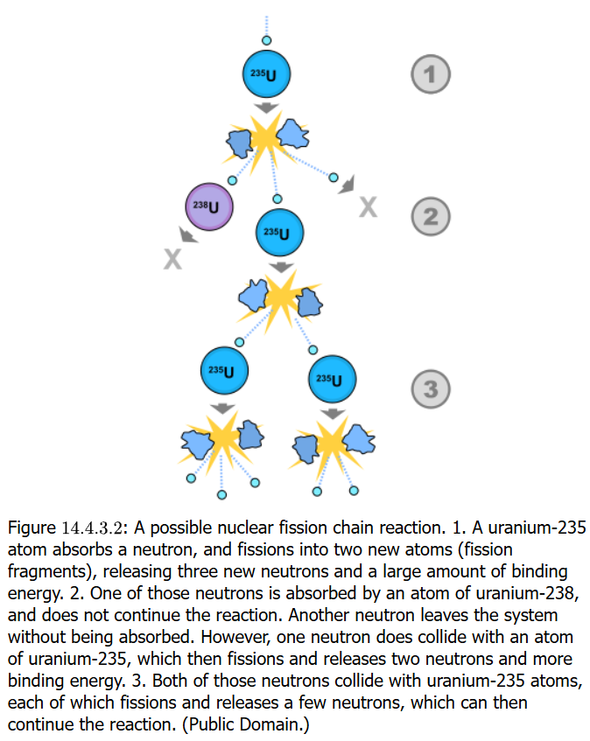
Fission Chain Reaction
Nuclear fission of U-235 is a self-sustaining chain reaction in which a neutron starts the process and yields three neutrons, any of which can strike another U-235 atom and continue with another fission
Nuclear-based energy and usually low energy level radioisotopes have many constructive and useful applications, not just in weapons

Slide 20
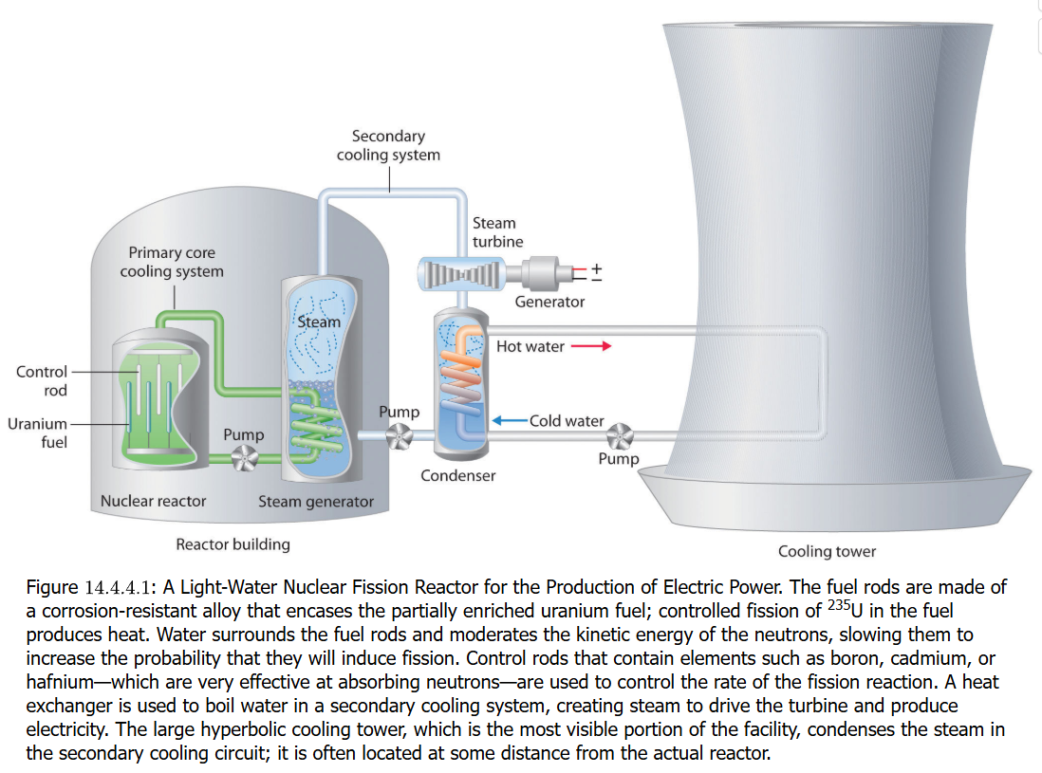
Nuclear-Generated Electrical Energy
1831: Faraday shows that a coil of wire rotated/ moved in a magnetic field produced by permanent magnets generates an electric current (electrical energy) in the principle of electromagnetic induction
Turbines are made of coiled wires within magnetic fields (permanent magnets) attached to a shaft with fins/blades: water that flows by falling (force of gravity) through hydroelectric dam penstocks
Similar turbines are in nuclear power plants: nuclear energy heats water that turns into steam that makes the turbines turn to generate the electricity to power the grid

Slide 21
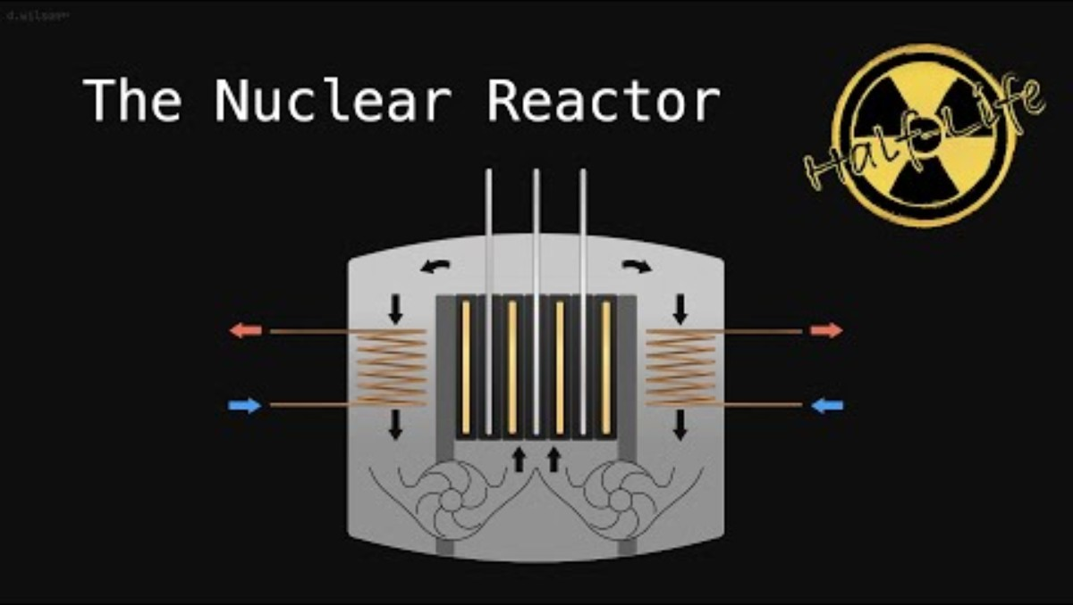
Elements of Controlling Fission
Naturally occurring uranium is 99% U-238, <1% U-235 isotopes
²³⁵U is what is needed for fission: the uranium ore is processed to achieve 3-5% ²³⁵U enrichment. ²³⁵U oxide is produced and its pellets packed into fuel rods
Design of the reactor includes control rods to absorb neutrons to prevent uncontrolled chain reactions and especially to prevent nuclear explosions that result from radioactive materials reaching critical mass (as occurs in weapons)
Trivia: A 1000 MWe reactor will consume about 27 tons (24,500 kg) enriched uranium annually, although this is only 1240 kg of fissionable ²³⁵U mass (3.4 kg/day). One kilogram 235 can generate energy of 1500 tonnes of coal. Energy transduction is 1000 MWe for 3000 MWt, meaning it is only a third efficient

Slide 22
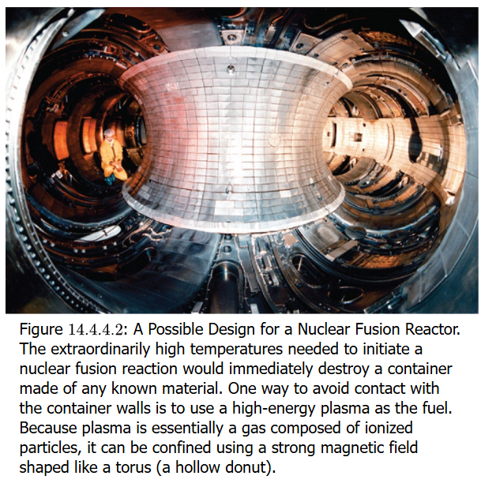
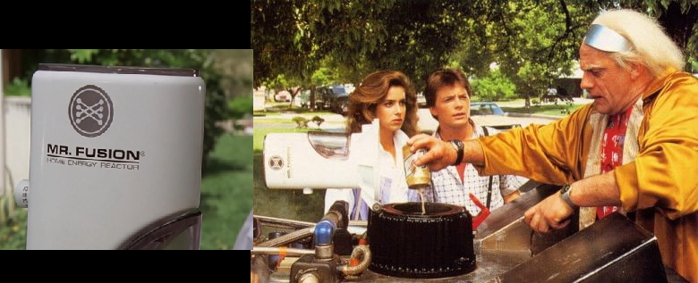
Fusion
The sun provides energy through a fusion reaction of hydrogen (¹H) nuclei sustained my millions of degrees of heat energy
Humans are trying to develop a sustained fusion reaction with considerable effort to harness it with
the potential of an output of energy well beyond the input of energy/cost to produce it

Slide 23
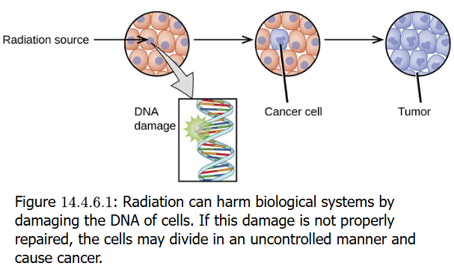
Radiation Affecting Life
Unstable nuclei of atoms can produce radiation in form of particles (alpha, beta) or electromagnetic radiation (gamma rays)
The energy can produce high heat and break chemical bonds of biologically important molecules that can affect cells and tissues containing these damaged molecules
Even without a lot of heat energy, radiative energy of low level might damage DNA responsible for making sure cells code correctly for proteins. The disruption could lead to a cell losing its control to replicate, leading to sporadic cancerous tumors

Slide 24
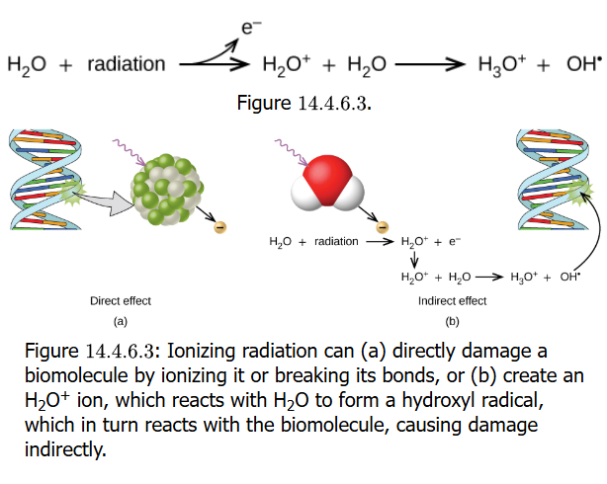
Ionizing Radiation
The electromagnetic spectrum is made up of nonionizing radiation (radio, microwaves, infrared, visible light) and ionizing radiation (ultraviolet, X- and gamma radiation, and the particles)
Ionizing radiation has the effective of breaking chemical bonds that should not be broken, disrupting the structure and function of biomolecules
A direct effect would be radiation damaging biomolecules directly
An indirect effect would be to create a damaging form of a water (H₂O) molecule and it interacting with a biomolecule

Slide 25
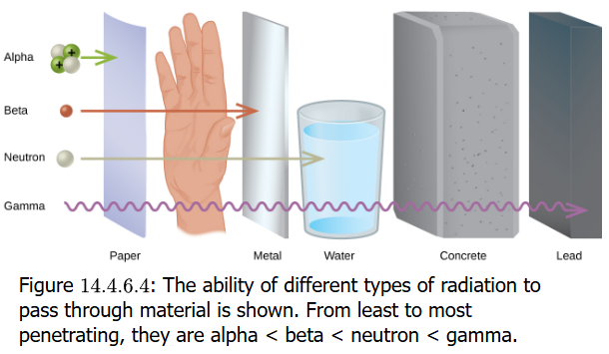
Radiation Exposure Biological Effects
Radiation can cause damage to cells which could become cancer cells that limit harm to individual
Could also damage DNA of germline (“reproductive”) cells that lead to genetic disease in next generation (children)
Alpha particles are more powerful as ionizing radiation but are so big they travel only a short distance, so they do more damage if ingested & not if outside the body
Beta particles can pass through tissues, but are less ionizing than alpha particles. A thin sheet of metal or a few centimeters of Plexiglas (transparent) will stop beta whose radioisotopes are used in experimental research laboratories
Gamma radiation usually requires thick lead. Experimental scientists only use “low energy” gamma isotopes and limit their exposure

Slide 26
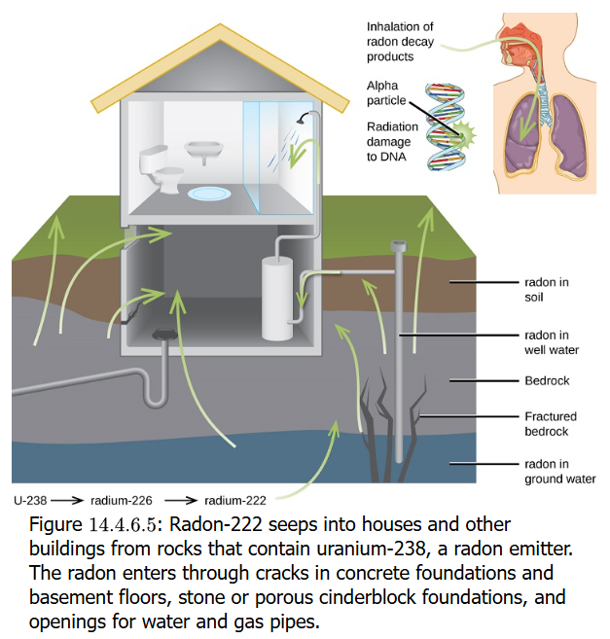
Radon (Rn-222)
The alpha emitter Rn-222 is produced naturally when ²³⁸U in soil and rocks decays
It is a gas but a dense one that can accumulate in basements and lower floors of homes, being concentrated at levels that are 3 times higher than in outside air. 1 in 6 houses have levels so high they need special treatment
Radon can significantly increase risk of lung cancer
This cancer in nonsmokers attributable to radon & results in 20,000 US deaths annually

Slide 27
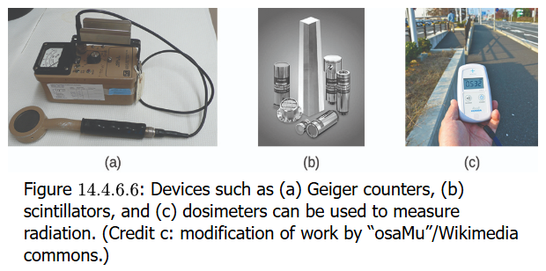
Detecting Radioactivity
Devices and systems detecting all forms of radiation exist
The Geiger-Müller tube detects electromagnetic (gamma, etc) radiation with gas particles in a chamber ionizing. This device mentioned in previous slide
Scintillation counting systems put the radioisotope in an organic solvent with compounds that fluoresce when the decay event occurs: the fluorescence triggers a photodetector
Dosimeters make use of various technologies, from exposure of photographic film, to electronic registers, quartz fiber, and thermoluminescent.

Slide 28
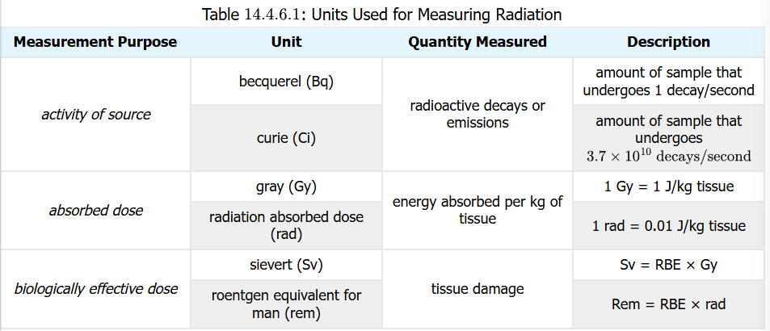
Measuring Radioactivity
The becquerel (Bq) is SI unit, representing 1 disintegration per second (dps)
The curie (Ci) is 3.7 × 10¹⁰ dps (37 billion dps). Scientists working with radioisotopes in research usually use microcurie (µCi) amounts
Doses of radiation to measure exposure use the gray (Gy). This is 1 J energy per kilogram tissue. The rad is 1/100th of a Gy
The sievert (Sv) is the SI unit for determining damage to tissue: it takes into account both the energy (in Gy) and relative biological effectiveness (RBE) of radiation exposure.
The roentgen equivalent for man (rem) is used to indicate damage & exposure in people. 100 rem = 1 Sv

Slide 29
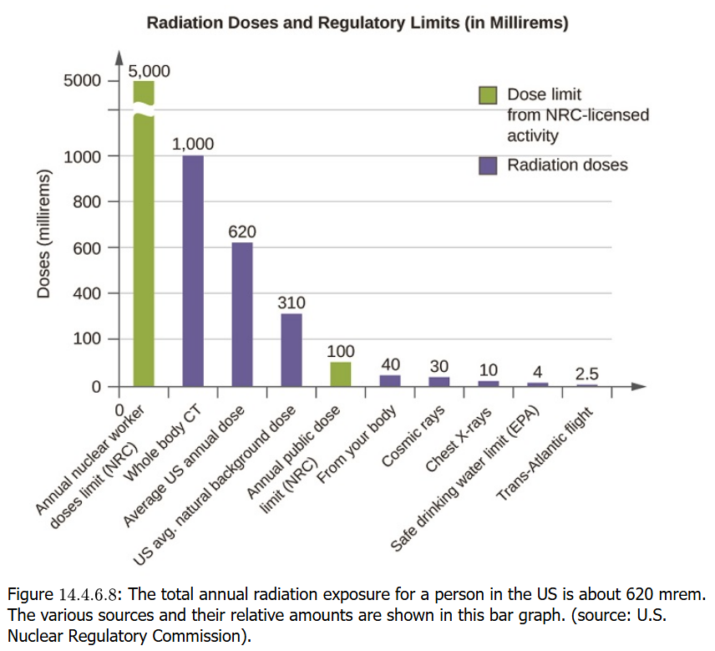
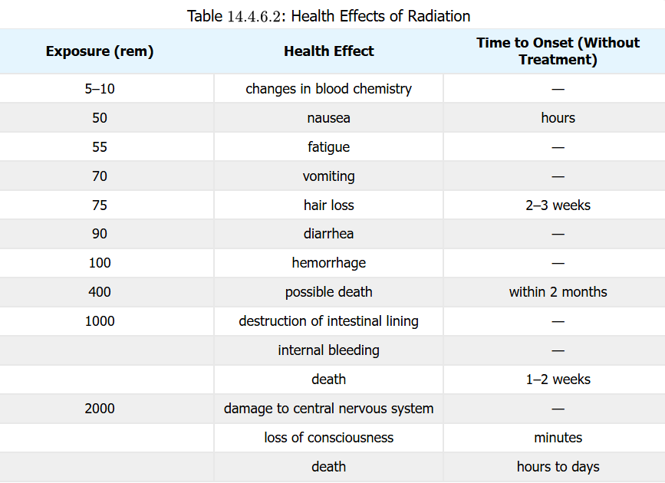
Long-Term Radiation Exposure
Multiple factors determine how damaging radiation can be: type, energy, distance from radiation, time of exposure
Tens of rems can cause noticeable symptoms and illness. A 500 rem dose could lead to death (50% probability within 30 days). The effects can be cumulative over a lifetime

Slide 30
Nuclear Medicine
The thyroid gland produces iodine-containing hormones that regulate metabolism. The gland can be subject to diseases and disorders, like goiter and cancers
Iodine-131 (¹³¹I) is an isotope useful in diagnosis, including gland imaging, and particularly at the right levels in therapy by killing gland cells that become overactive (hyperthyroidism) and restoring health
Of interest is that patients being treated with I-131 and who may travel by air may have to carry a special notice indicating to travel security officials their treatment, since half-life of isotope is about a week and they may trigger radiation detectors

Slide 31
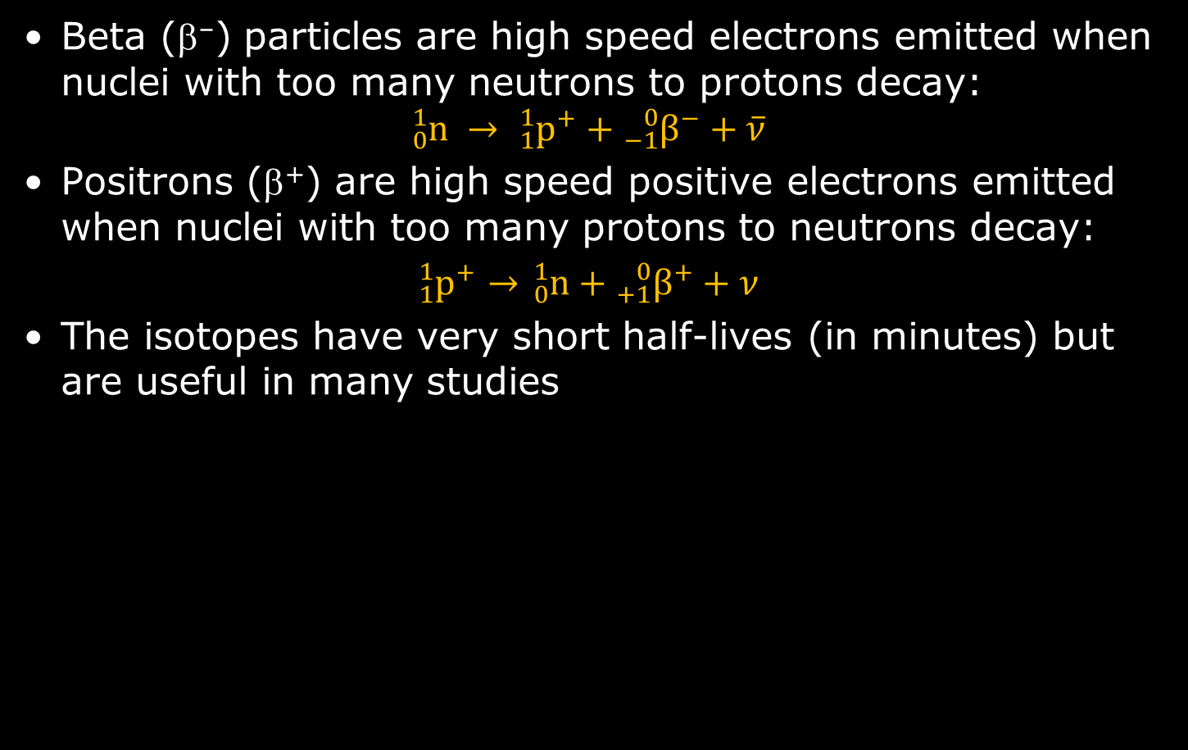
Positron Emission Tomography (PET)
Beta (β–) particles are high speed electrons emitted when nuclei with too many neutrons to protons decay:
$${}_{0}^{1}n → {}_{1}^{1}{p^{+}}+{}_{−1}^{0}{β^{−}}+\overline{ν}$$
Positrons (β⁺) are high speed positive electrons emitted when nuclei with too many protons to neutrons decay:
${}_{1}^{1}{p^{+}}→$ ${}_{0}^{1}n+{}_{+1}^{0}{β^{+}}+ν$
The isotopes have very short half-lives (in minutes) but are useful in many studies

Slide 32
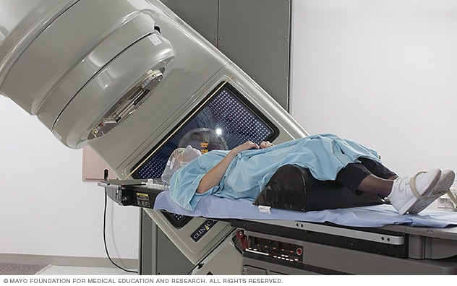
External Beam Therapy (EBT)
This concept of targeting diseased—such as cancerous—tissues with a focused destructive radiation beam narrowed at tumors and cancer cells has made gains with the use of technologies such as computed tomography (CT) that can map the diseased areas three-dimensionally
Cancers of the head and neck, breast, colorectal region, the lungs, and prostate are part of the overall plans for management of therapy that incorporate radiation use

